Slide 1

DILCIS Board
Meeting 2018-05-30

Slide 2

Agenda
Secretary of the meeting
Welcome to special guests: Bundesarchiv, National Archives of Norway, Jaime, Karin, Carl
Who are we?!
AoB to be added?
Latest news on CEF (David)
Finalizing the workplan (Karin)
SIARD (Anders Bo + Krystyna)
CS IP (Kuldar)
Ca 16.00 package validation discussion with A3, OPF and Carl Wilson
Next meeting

Slide 3
Welcome!!!!
A presentation round!

Slide 4
Secretary and AoB
Secretary? Notes to be published on Git!
AoB?

Slide 5
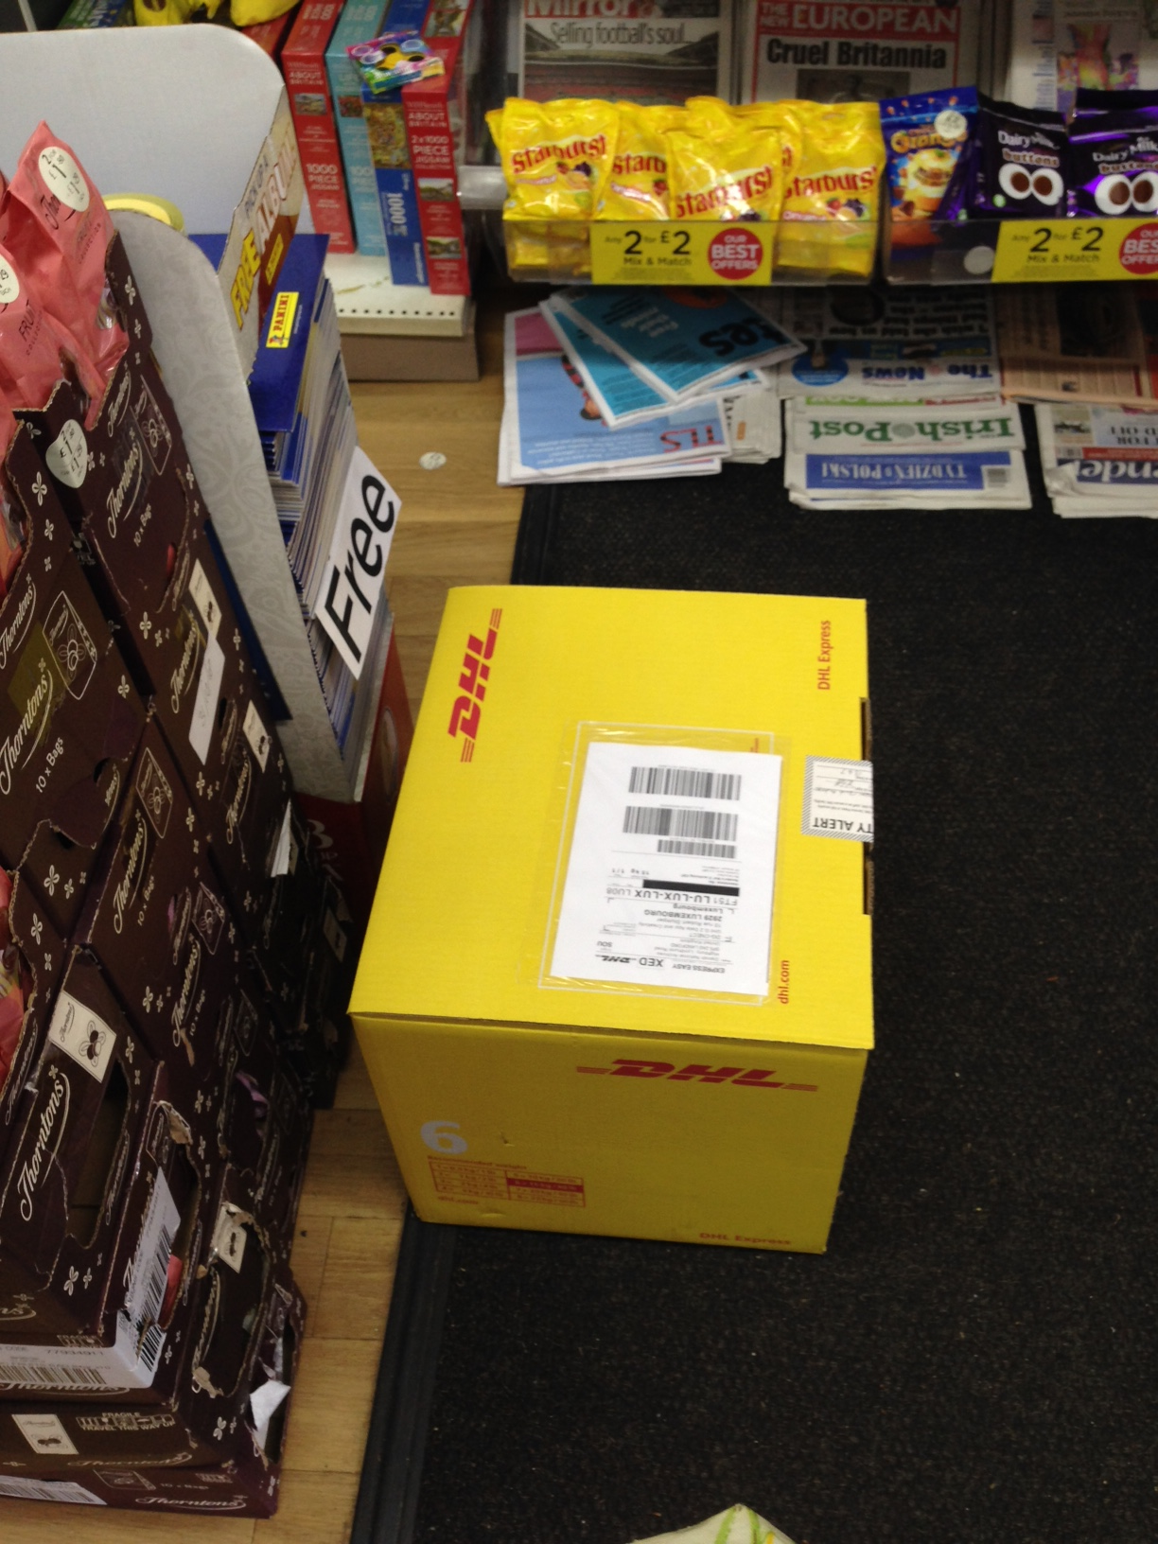
Update on CEF in General
News?

Slide 6
Workplan

Slide 7
Specifications Activity within CEF - review
Milestones
Milestone number | Milestone description | Milestone summary | Indicative completion date | Mean(s) of verification
M2.1 | CS IP Specification update | Specifications: Technical update of Common Specification for Information Packages | M03 | CS IP Specification (technical document and XML schema)
M2.2 | CS IP, SIP, AIP, DIP, SIARD, Geo-data and ERMS Specification update | Technical as well as textual update of specifications: Common Specification for Information Packages Profile for SIP Profile for AIP Profile for DIP SIARD Geo-data ERMS This milestone has a waypoint in month 6 where the specifications can be sent out for review and testing for a 3-month period | M11 | CS IP, SIP, AIP, DIP, ERMS, Geo-data and SIARD Specifications (documents, XML-schemas and Schematron-documents)
M2.3 | Guidelines for new, review and revision of, specifications | Best practices guidelines for developing new Content Information Types including review and revision guidelines created. | M12 | Guideline for specifications

Slide 8
Workplan update
Some changes needed in the one we have
Month 3 CS IP ready
Month 6 all specifications needs to go out on review!
Month 9 answers back
Month 11 publication of all specifications
Month 12 publication of guidlines for new, review and revision
You have the link! https://drive.google.com/open?id=1j8fvUf5wslgtesQ69lUpUO-onhZdfWCi

Slide 9
SIARD
Plan forward?

Slide 10
CS IP
Delivered!
Read?

Slide 11
AoB

Slide 12
Next meeting?
June/July/August?

Slide 13
Next F2F
DLM Forum Vienna 28th of November 9.00-12.30
Launch of review versions? 30th of November Vienna????

